Slide 2
Working With OLAP Part 2
OLAP Part 2
The OLAP Cube
Pre-Filtering the Cube
Building Views
Exporting Views to Excel
Summary
User Q&A

Slide 3
The OLAP Cube
At the core of the OLAP concept is an OLAP Cube. The OLAP cube is a data structure optimized for very quick data analysis.
The OLAP Cube consists of numeric facts called measures which are categorized by dimensions. OLAP Cube is also called the hypercube.
Usually, data operations and analysis are performed using the simple spreadsheet, where data values are arranged in row and column format. This is ideal for two-dimensional data. However, OLAP contains multidimensional data, with data usually obtained from a different and unrelated source. Using a spreadsheet is not an optimal option.
The cube can store and analyze multidimensional data in a logical and orderly manner.

Slide 4
Building an OLAP Cube

Slide 5
Prefiltering Data Inventory

Slide 6
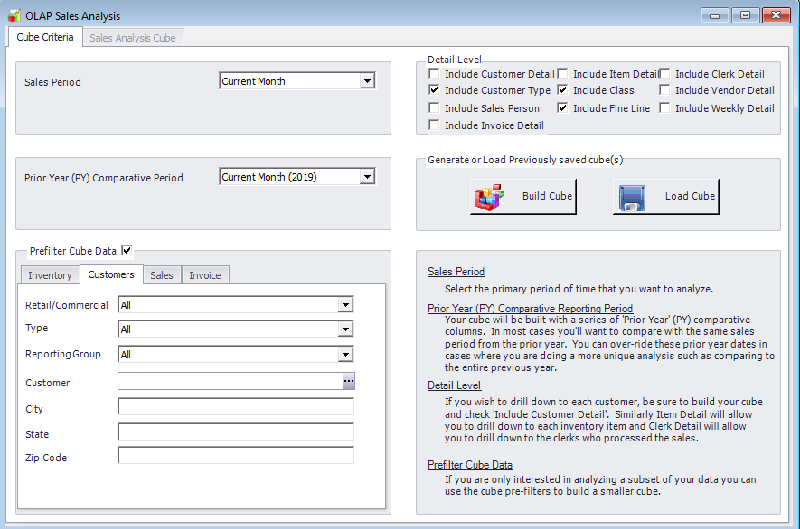
Pre-filtering Data Customers

Slide 7
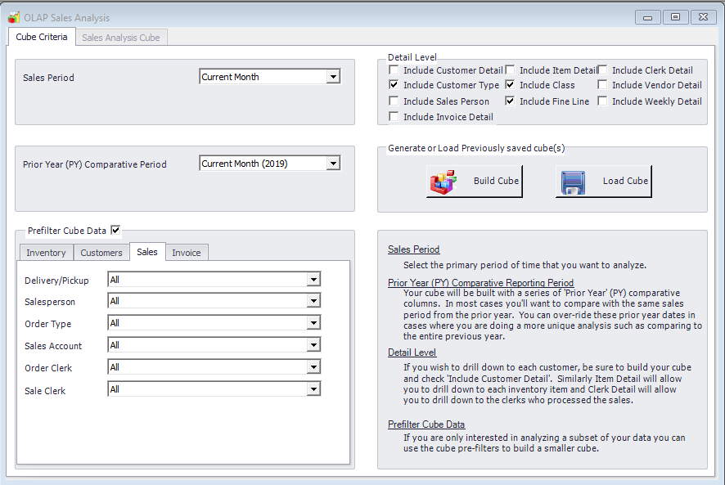
Prefiltering Data Sales

Slide 8
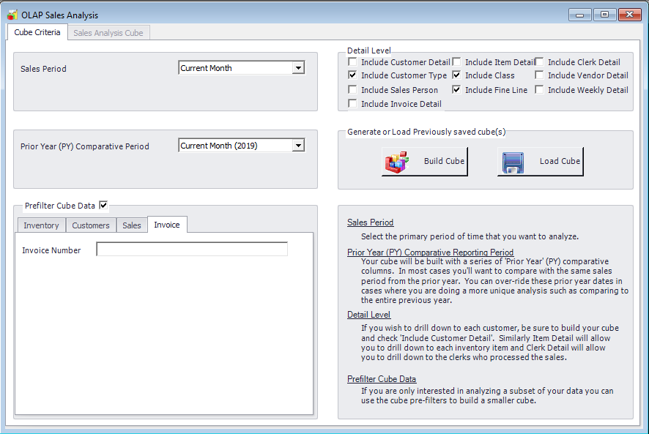
Prefiltering Data Invoice

Slide 9
Cube Detail Level
Include Customer Detail
Include Customer Type
Include Sales Person
Include Item Detail
Include Class
Include Fine Line
Include Clerk Detail
Include Vendor Detail
Include Weekly Detail

Slide 10
Saving a Cube

Slide 11
OLAP Views
An OLAP view (also called an analysis view) represents a selective set of multidimensional data in a given cube. It is usually defined to meet a specific need, such as to analyze sales trends or to profile customer demographics.
The view is defined in terms of an OLAP connection. The OLAP connection specifies the data access properties, the data available to view is determined by the data included in the creation of the OLAP cube.

Slide 12
Sales By Gallons View Creation
Go To Reports
Select OLAP Sales Analysis
Select Sales Period
Z Axis: Sales, Gallons, Margin%, PY Sales, PY Gallons, PY Margin%
X Axis: Commercial/Retail, Month
Y Axis: Department

Slide 13
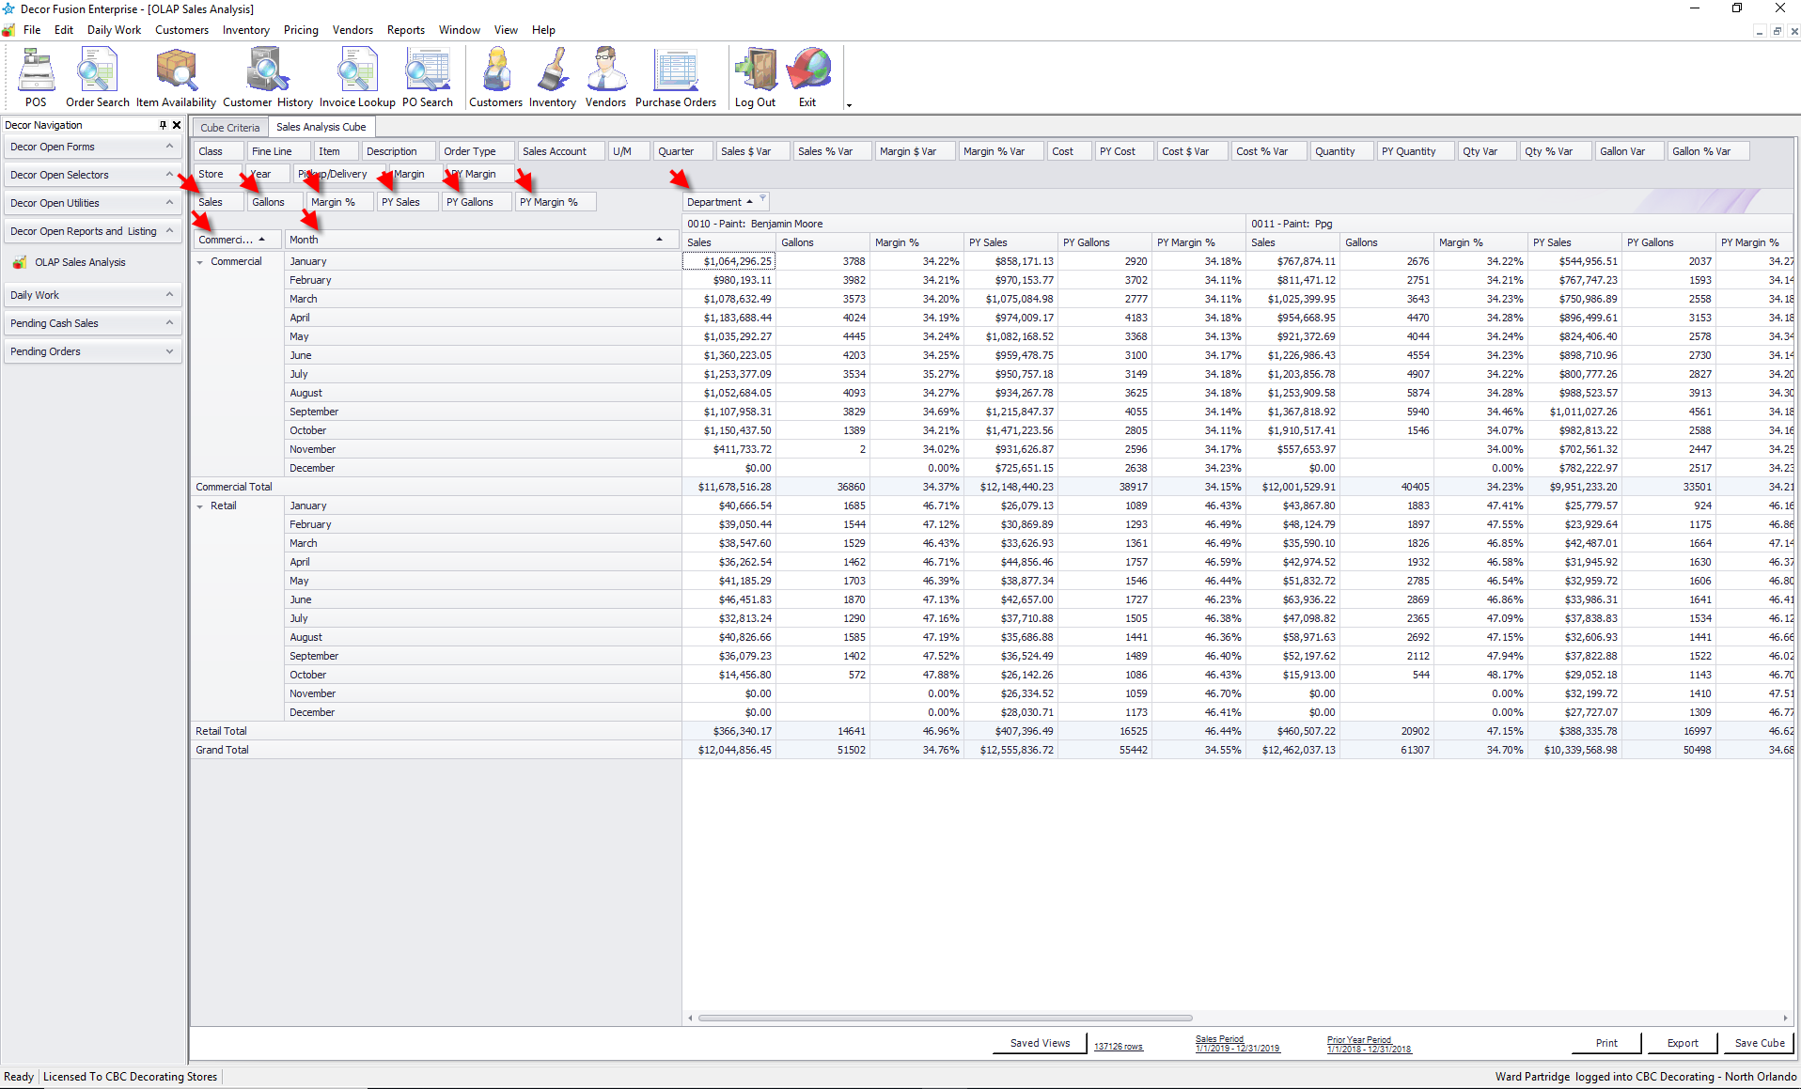
Sales By Gallons View

Slide 14
Sales By Department View
Go To Reports
Select OLAP Sales Analysis
Select Sales Period
Build the Cube
Z Axis: Sales, PY Sales
X Axis: Department
Y Axis: Commercial/Retail

Slide 15
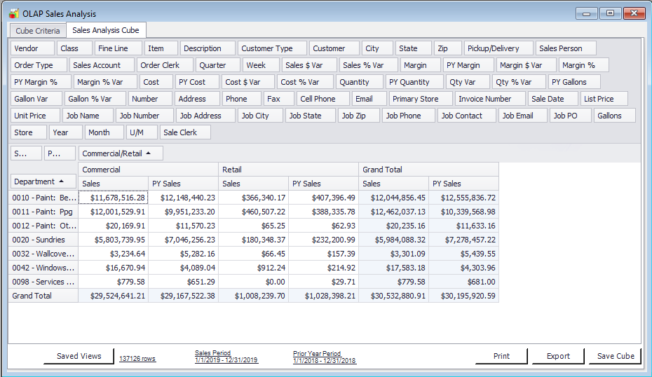
Sales By Department View

Slide 16
Sales By Clerk by Department View
Here is a nice one, that shows sales by department so you can see what clerks are selling add-on sundries vs just taking paint orders… really need to jump out to excel, add up paint dept and then compare to sundries as % of paint sales by users.

Slide 17
Sales By Clerk By Department View
Go To Reports
Select OLAP Sales Analysis
Select Sales Period
Build the Cube
Z Axis: Sales
X Axis: Department
Y Axis: Sales Clerk

Slide 18
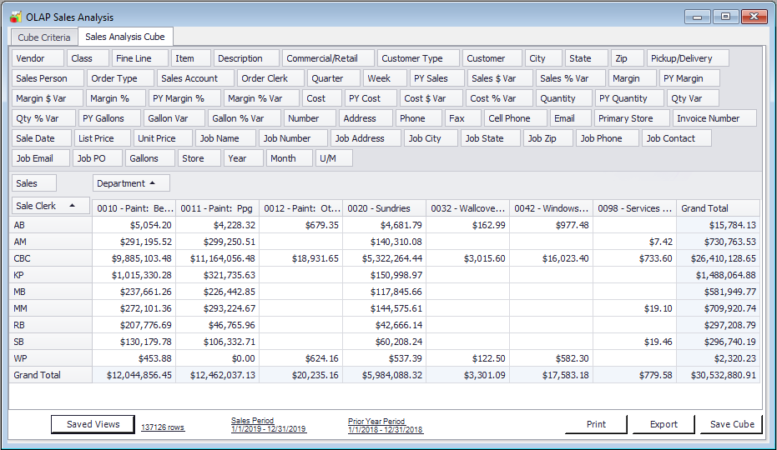
Sales By Clerk by Department View

Slide 19
Saving a View

Slide 20
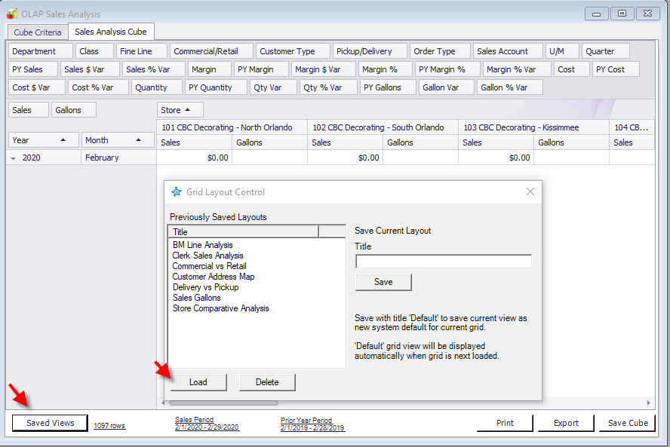
Recalling a View

Slide 21
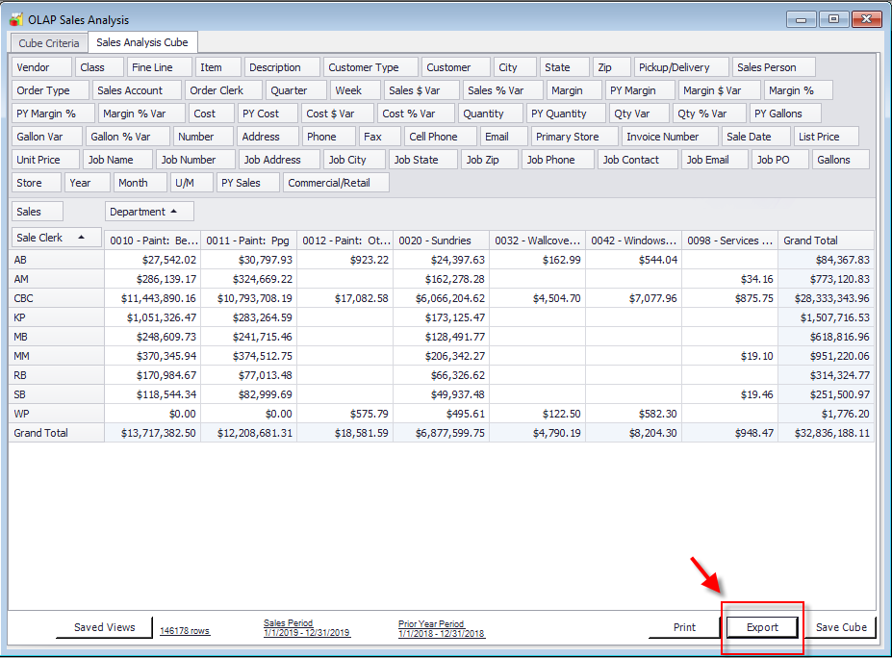
Exporting a View

Slide 22
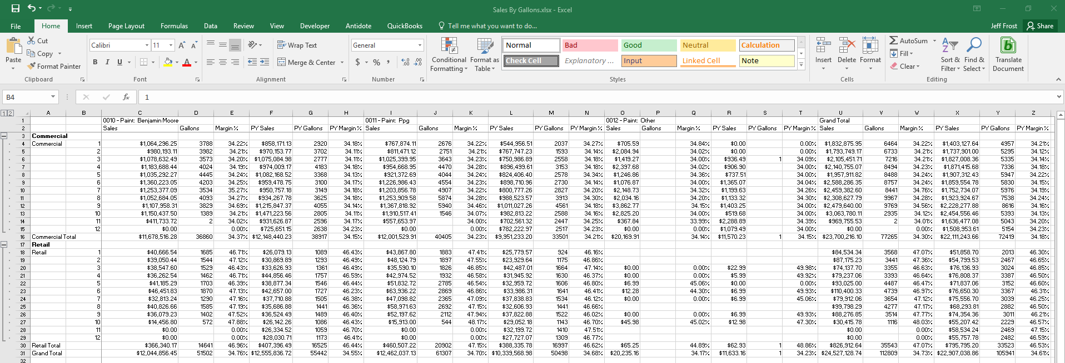
Reviewing in Excel

Slide 23
Summary
OLAP Cubes are pictures in time of your database.
OLAP Views are re-usable lenses to view those pictures.
Don’t be afraid of OLAP you control the outcome.
OLAP Part 3 is coming soon!
Notes:
.

Slide 24
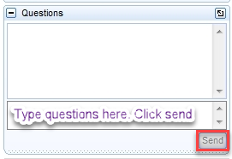
User Q&A
Please submit any questions in the Question section on the GoToWebinar window.

